Slide 1
Introduction to the lithology file in PetroMod – Version 1.2
Mustafa Al Ibrahim
18.05.08

Slide 2

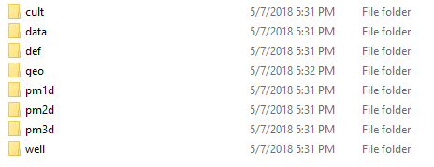
Where is the lithology file
It is in the “geo” folder in the project folder.
You might need to modify some parameter in the lithology editor for it to show up.

Slide 3
What is it?
XML file with 70,000 lines to parse.
Contain few main structures.

Slide 4
Which version of PetroMod are you using?
2016.1
The Lithologies file version is 2.1.
Question: what is the file version in 2015 petromods?

Slide 5
Lithology file components
Lithology File
Meta
Curve
Lithology

Slide 6
Meta
Contains the list of names of parameters
You shouldn’t modify this table but you should use it to know the parameter names from parameter id.
Most Important
Group
Read
only
Subgroup
Read
only
Subgroup id
Subgroup name
Parameter
id
Parameter
name
Parameter
type
Default
value
Petrel
template
Read
only
Group id
Group name
Unit

Slide 7
Curves
Contains any curve defined in lithology (e.g. compaction curve)
Most
Important
Most Important
Group
name
Group
read only
Curve
id
Curve
name
Curve
read only
Petral
Template x
Petral
Template y
Unit
x
Unit
y
Group id
Points

Slide 8
Lithology – Part 1
Contains all the lithologies collapsed into one table
What is petromod id? It looks like it is just a unique number that will be used in the model. So when defining new lithology, we need to take care of it.
Most Important
Important?
Most Important
Group
Petromod
id
Subgroup
Petromod
id
Lithology
id
Lithology
name
Lithology
Read only
PetroMod
Id
Pattern
id
Group
id
Group
name
Group
read only
subgroup
id
subgroup
name
subgroup
read only
Color
Properties

Slide 9

Lithology – Part 2 - Properties
The properties for each lithology is a table which contain the following.
Parameter id can be checked in the meta table to obtain the name of the property
Value can be a number or a hash that points to a curve.
Parameter group id
Parameter id
Value

Slide 10
Notes about inserting new lithology or curve
If we are defining a new curve or lithology, how do we define the new id? It looks like an MD5 Hash which is good for us. Of what? Does it matter? I don’t think they will actually check the hash to make sure it matches the expected hash. I believe that they are using it for generating a unique id. This needs checking.

